Slide 1

Success at the (FL)Edge
Leveraging Open Source at the Edge as a Bridge to Critical Operations in Industry Richard Beeson, CTO, OSIsoft Bill Hunt, CTO Dianomic
24.09.2019

Slide 2
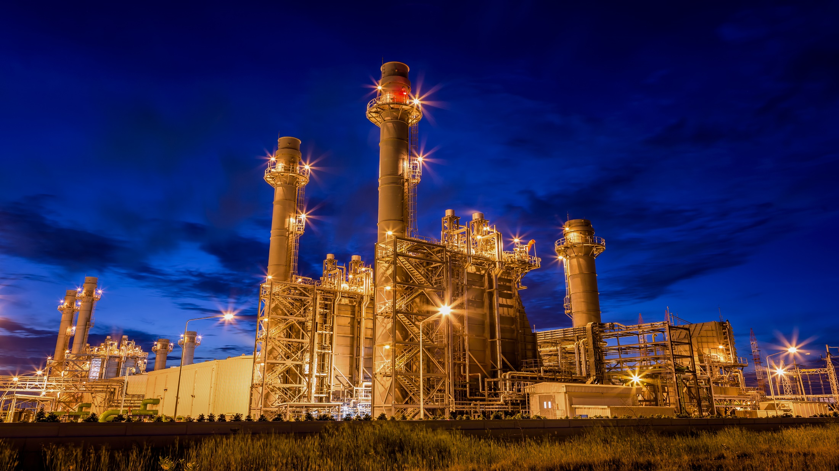
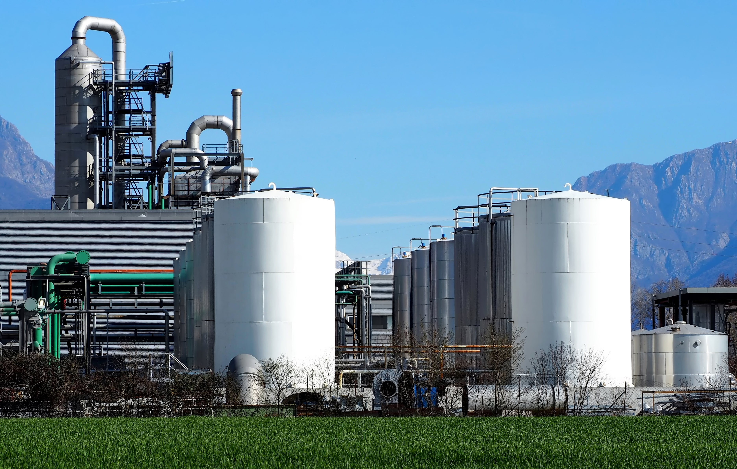
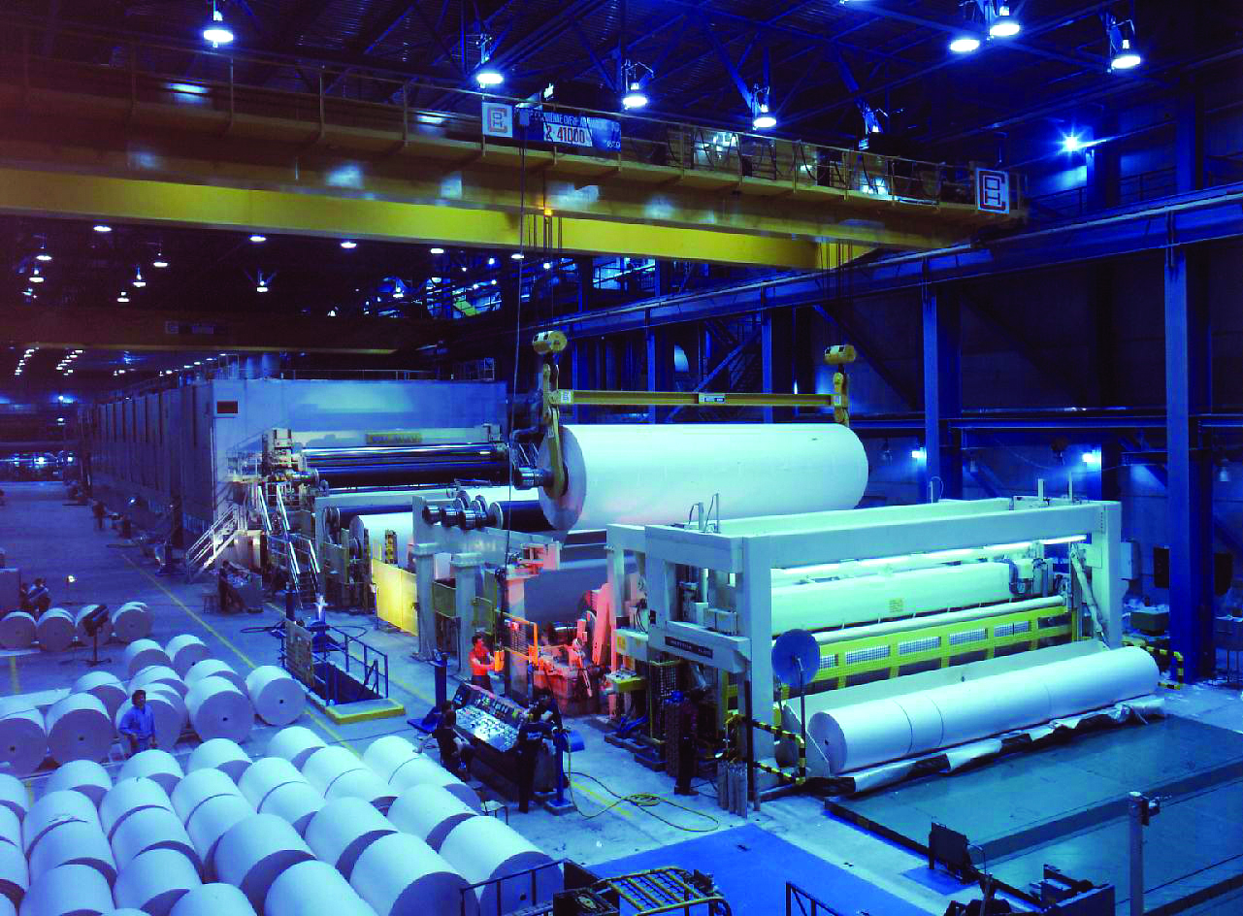

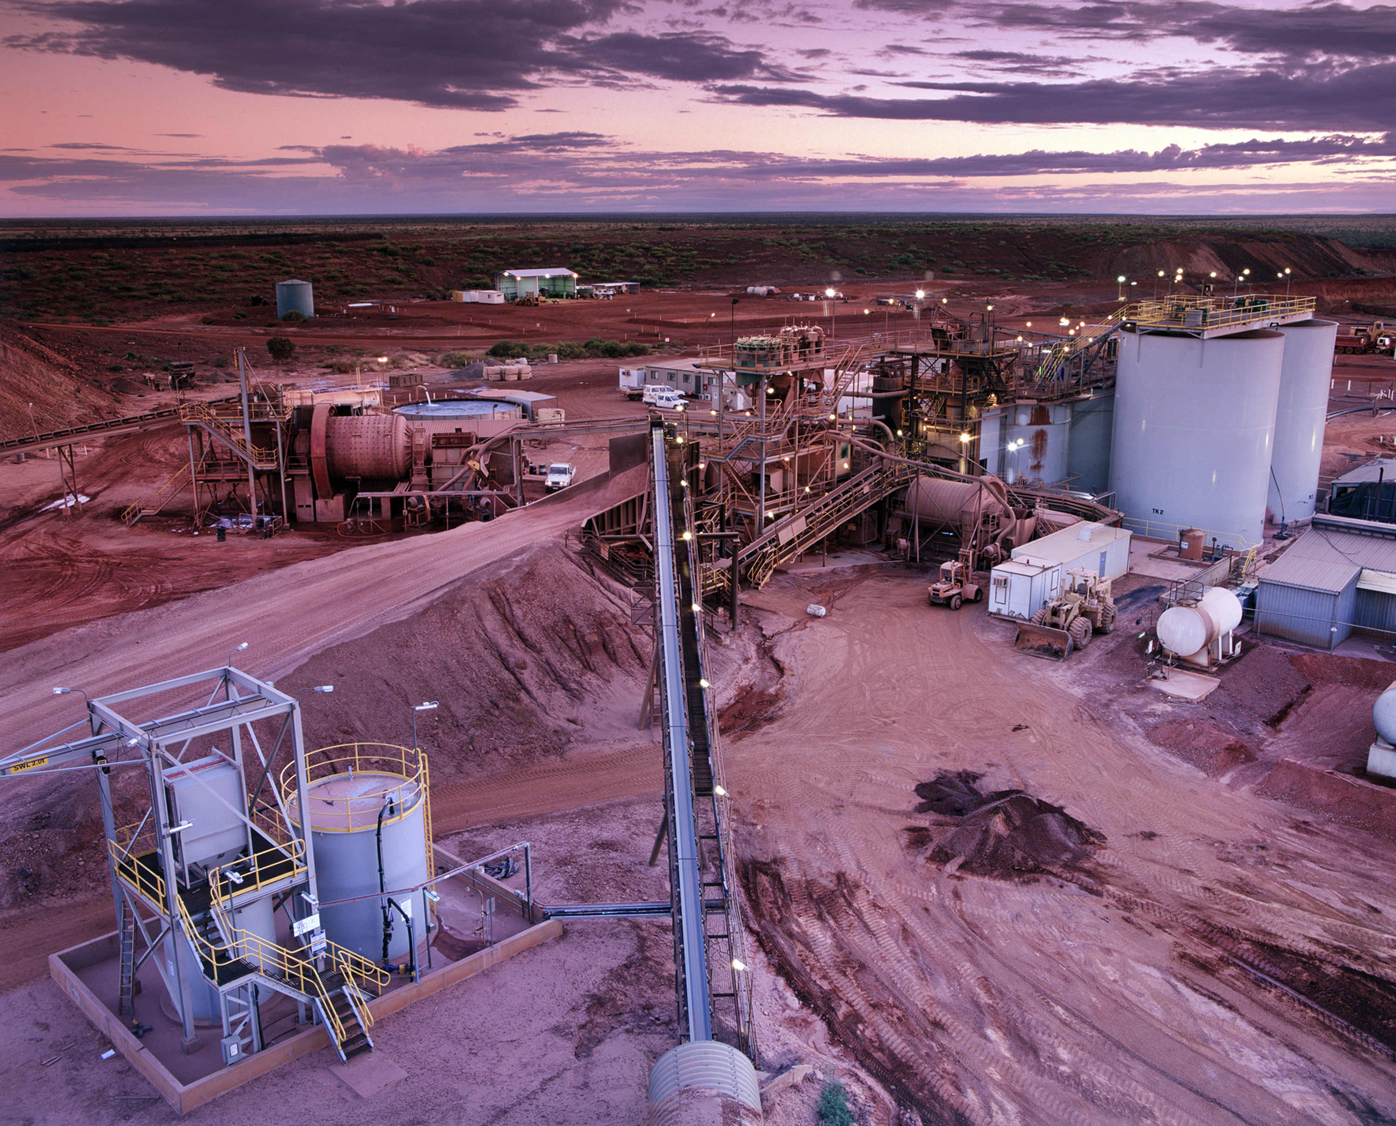
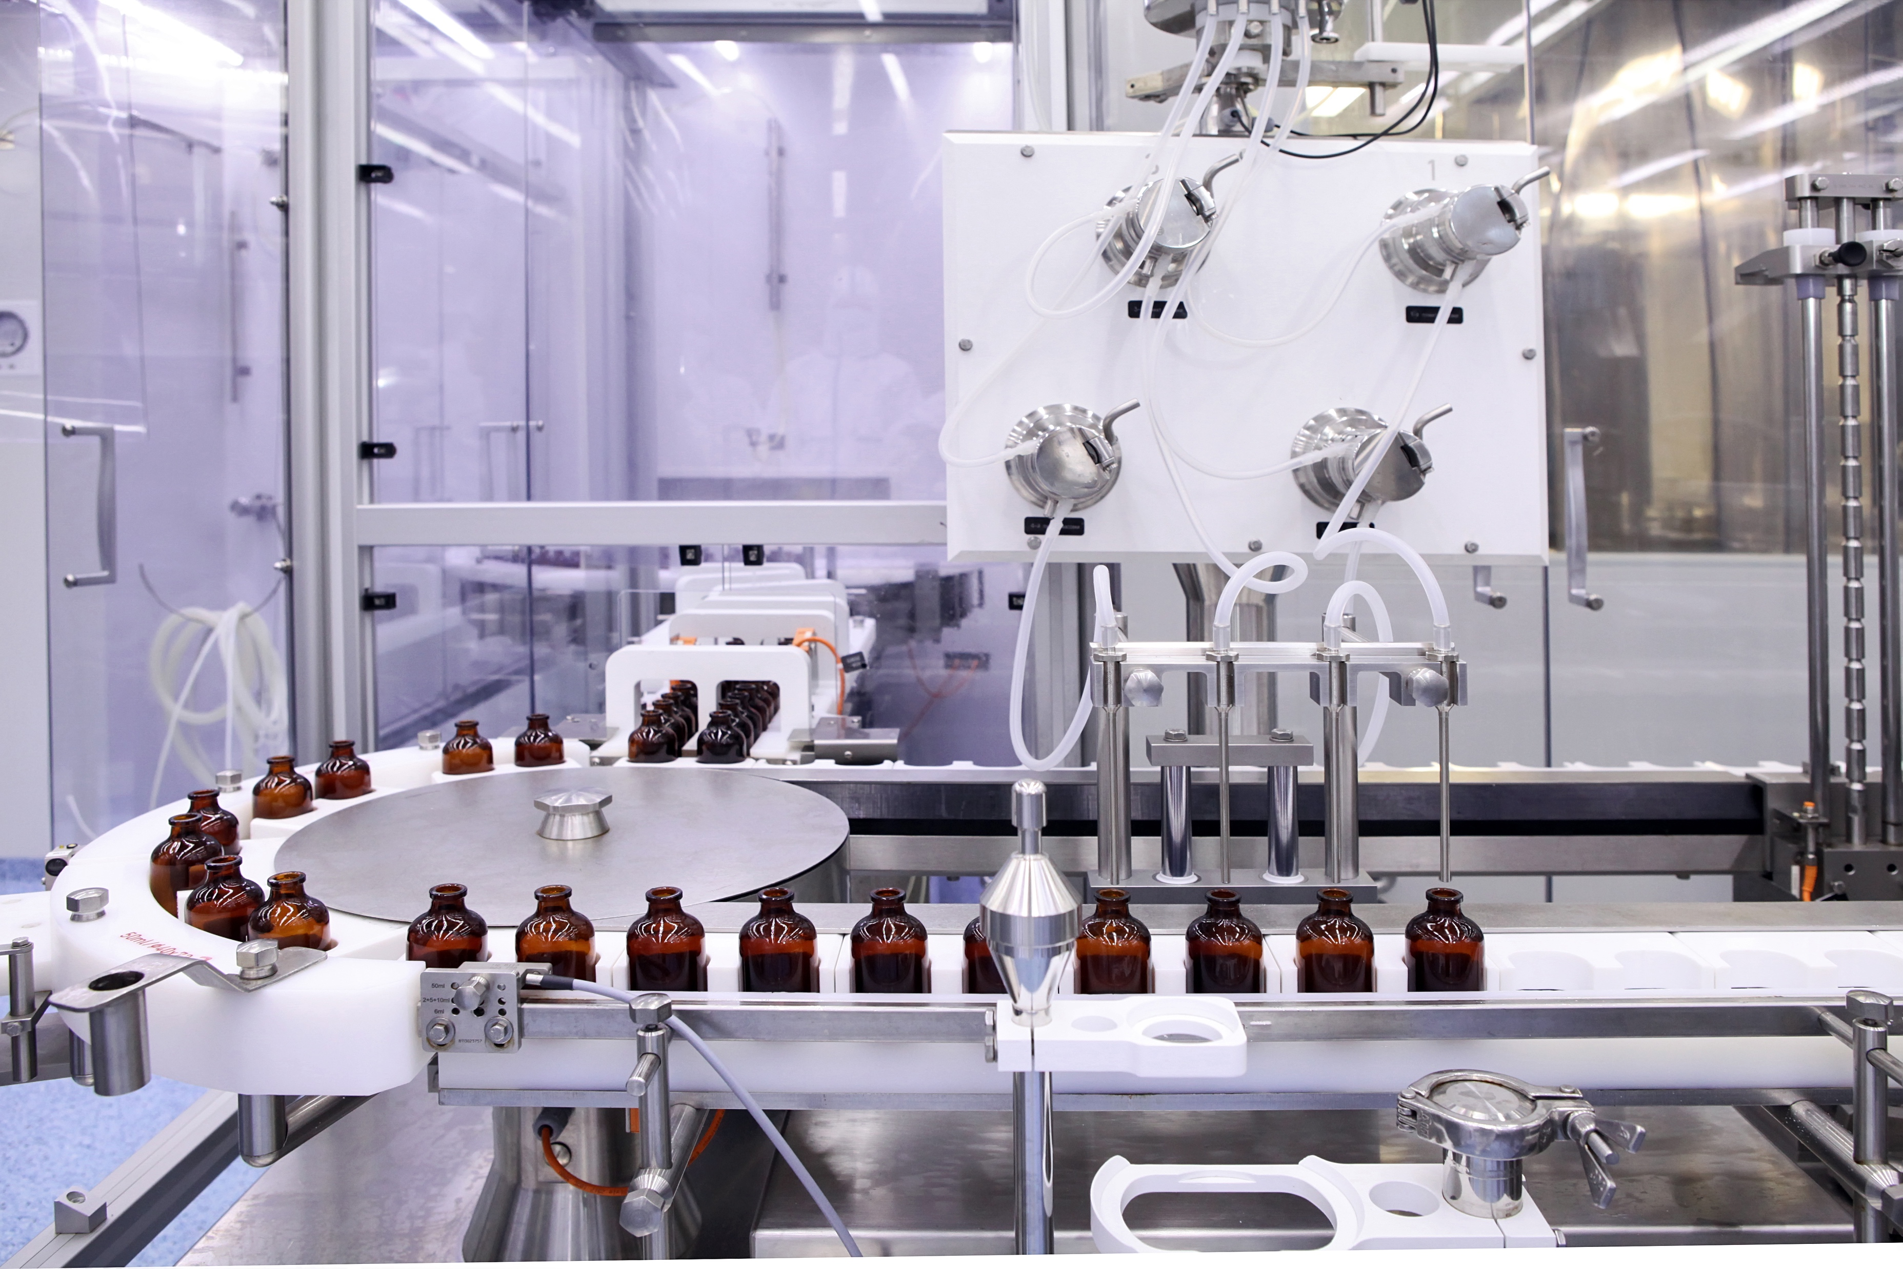

Slide 3
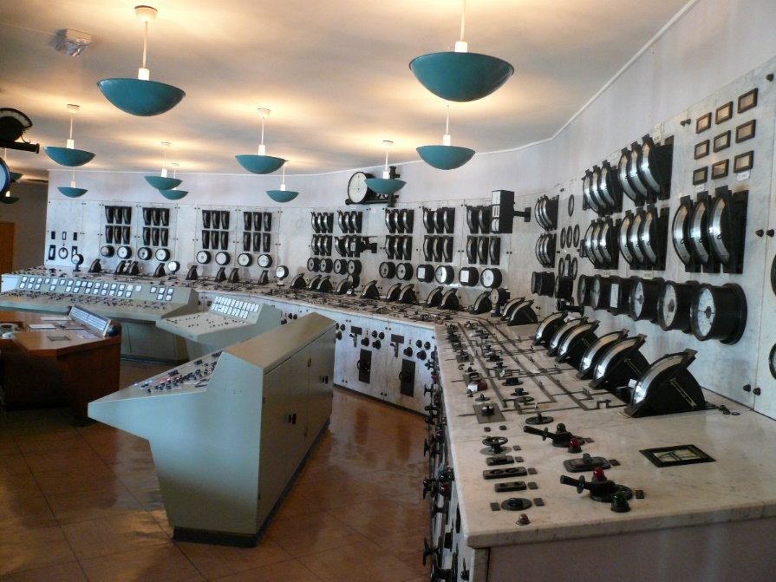
Early Control Room – Circa 1960’s
Central Control Room
Hundreds of sensors
Silos of Signals
Analog Readouts
Home Runs Needed for Piping and Wires
Integration at the Human
Simple Control
Picture Source: en.wikipedia.org/wiki/Distributed_control_system
Notes:
This is state of the art in the 60’s, in the 70’s they added digital displays.
This was a major advancement over distributed local control with no remote readouts.
That required process operator to get on a bike and/or radio and call for help to make a change.
This was integration at the Human.

Slide 4
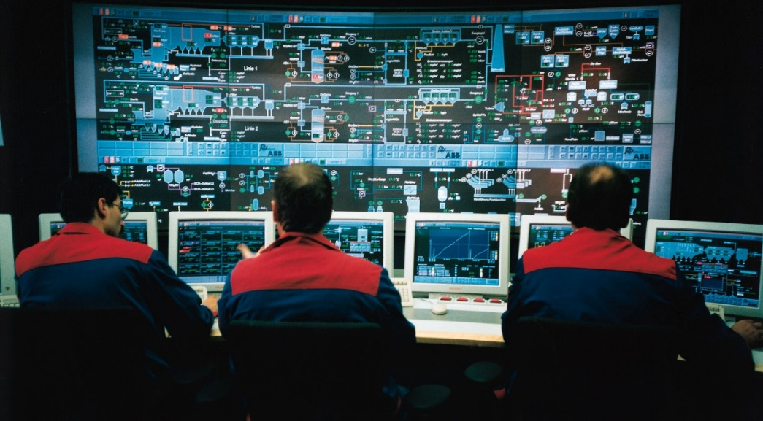
Distributed Control System (DCS)
Introduced Late 70’s
Thousands of sensors
Rolled Out In the 80’s/90’s
Updated Slightly Over Time
DSC Allows for Plant-wide Control
Advanced, Multivariable Control
Typically multiple DCS in a plant (7 in HI Independent)
VAX >> Unix >> Windows
Picture Source: en.wikipedia.org/wiki/Distributed_control_system

Slide 5
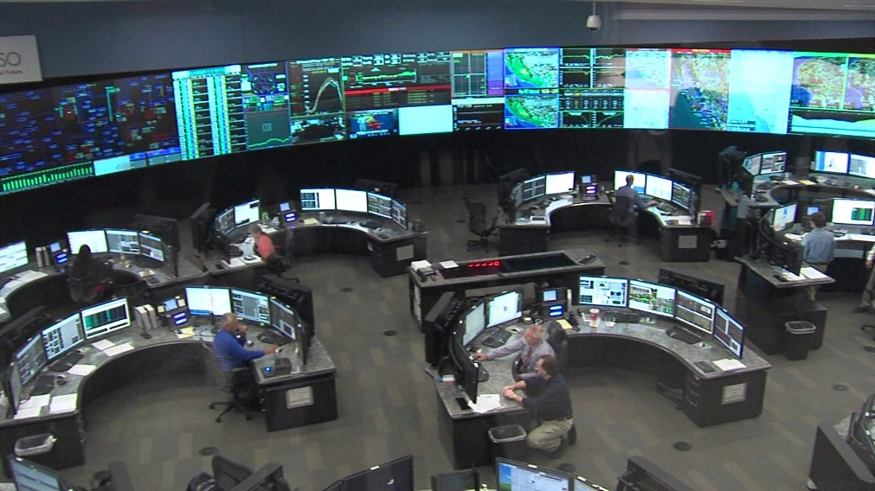
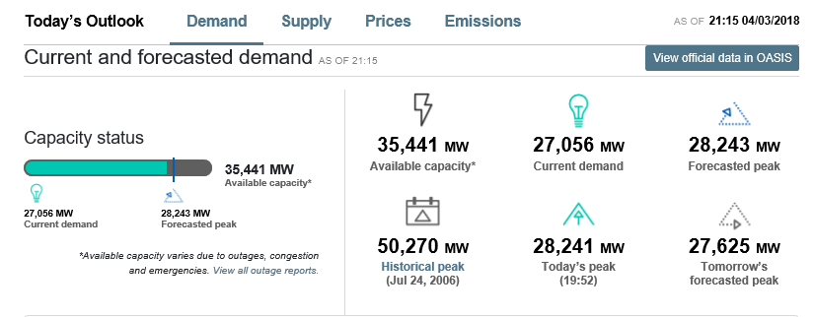
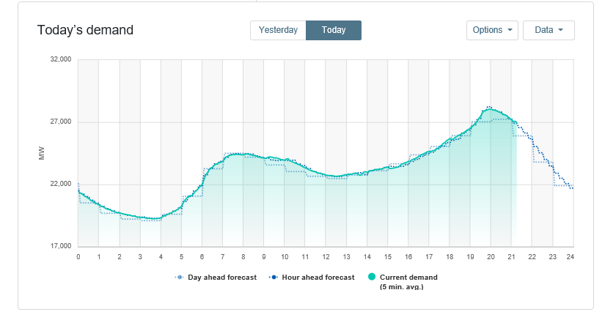
Electrical Infrastructure Supply Chain - Today
Redundant, Distributed Control Center Geography Dispersed/Diverse Control Cross Company Business Control
(Circa 1990’s - Today)
Source: California Independent System Operator (CALISO)

Slide 6
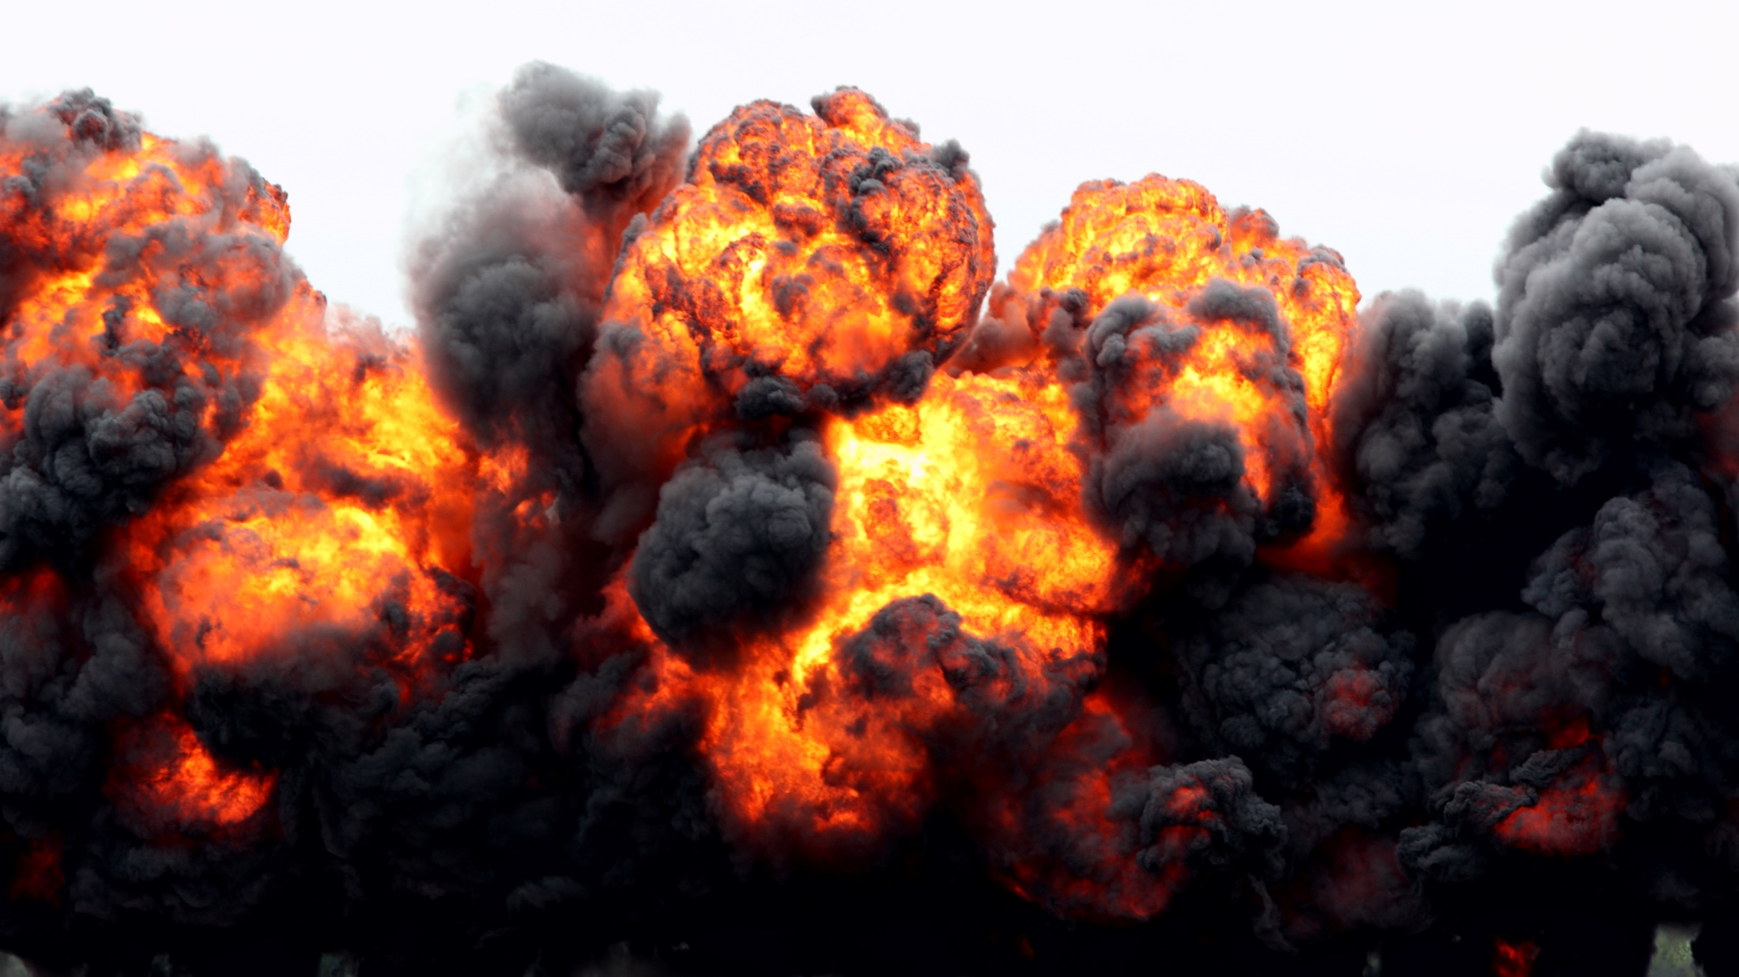

Slide 7
Data Integration can Address Big Questions
Notes:
Cost of adding sensor to control network in critical systems can be many $10s of thousands.
But the value of additional data can be significant.

Slide 8
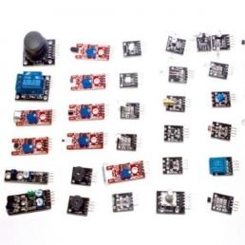
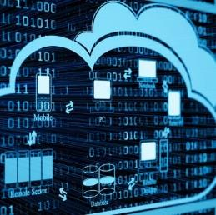

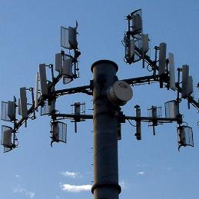
IIoT Enables Digital Transformations
Cheap, and tiny sensors
Decreasing compute and storage costs
New abilities to process and analyze data
Ubiquitous connectivity
Sensors on the Entire Supply Chain will Automate and Transform Business

Slide 9
Secondary IIoT Networks
Industrial DCS and SCADA systems are secure and reliable but also
Tightly regulated/controlled
Geographically challenging
Expensive
Networks of Non-SCADA data are becoming common
Massive Fragmentation and Complexity in Sensors and Machines
Large Brownfield needs to be supported/extended

Slide 10
The reality of new sensors today
1° Network
2° Network

Slide 11
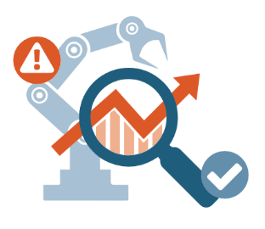
Efficiency is Everything
Maximizing Asset Availability/Usage is Critical
Strategies
Reactive Maintenance (Run-To-Failure)
Failures are a surprise, and resolving creates emergencies
Preventive (Scheduled) Maintenance
Down-time during maintenance/inspection
Significant cost of maintenance
Can still have surprise failures
Predictive (Condition-Based) Maintenance
Use data to predict when equipment needs maintenance
Ranges from simply monitoring oil temperature to running ML models
Reduced downtime and cost

Slide 12
Industrial Operators
Industrial SIs
Industrial Equipment
Vendors
Critical Operations Plant Wide
Condition-Based maintenance
Predictive maintenance
Situation awareness
Increased safety
OEE, TPM
How
Connect all machines, sensors
Put all data in plant wide context
Eliminate fragmentation and complexity
Use FLEDGE’s common APIs to manage, secure and operate as a system
Lead Industrial 4.0 Transformations
Accelerate deployments
More/tighter Integrations
Own and re-use your value-add code
Develop ML/AI expertise
Increase value delivered/hour
How
Connect all machines, sensors to old and new OT/IT Systems
Put all data in plant wide context
Build services around latest ML/AI tools
Use FLEDGE’s common APIs to manage, secure and operate as a system
Smarter more Autonomous Machines
Machines that learn
Machines that maintain themselves
Machines that integrate
New business models/higher margins
Machines that compete
How
Use latest ML/AI tools
Use modern architectures
Avoid proprietary APIs and cloud lock-in
Save development time and money
Use FLEDGE’s common APIs to manage, secure and operate as a system

Slide 13
Fledge Technology

Slide 14
Collect Data - from any/all sensors
Aggregate - combine and organize data
Transform - filter and transform data in-flight Buffer Data - reliability for poor connectivity
Edge Analytics - visualize data on the edge
Deliver Data - to multiple local/cloud destinations

Slide 15
Flexible and Scalable
FogLAMP is a single
device solution or…
Multiple Sensors
Hierarchy or Mesh
Multiple Destinations
Redundancy / Fail-Over
Transform & Buffer Data at all Layers

Slide 16
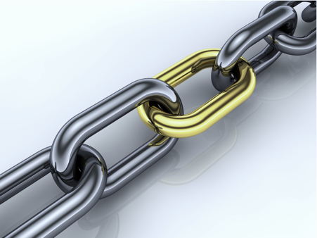
Reliable and Resilient – like a cable modem
Low-Effort Provisioning and Maintenance
Small (<50m memory required)
Fast (15,000 readings/second)

Slide 17
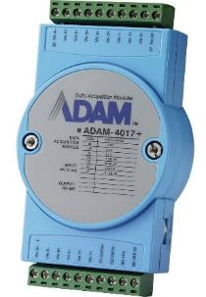
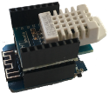
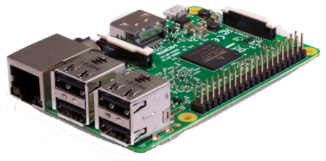
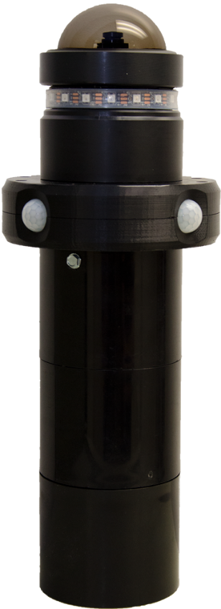
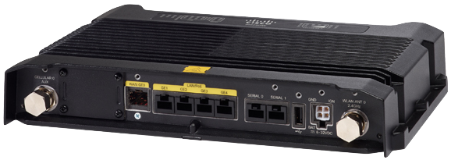
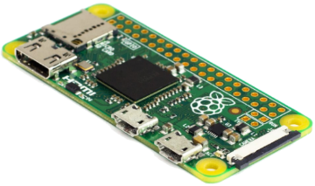
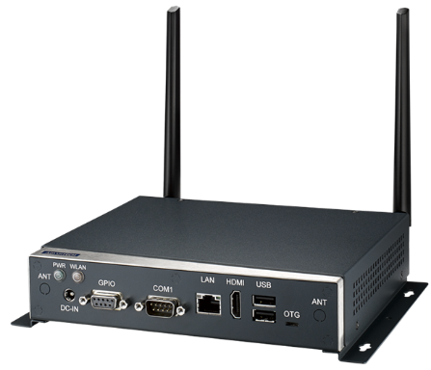
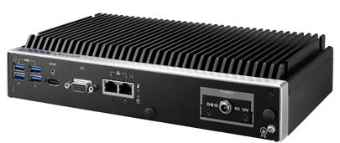
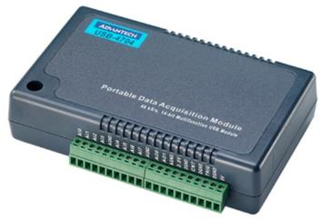
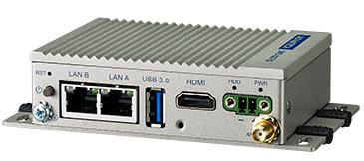
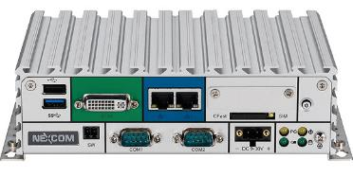
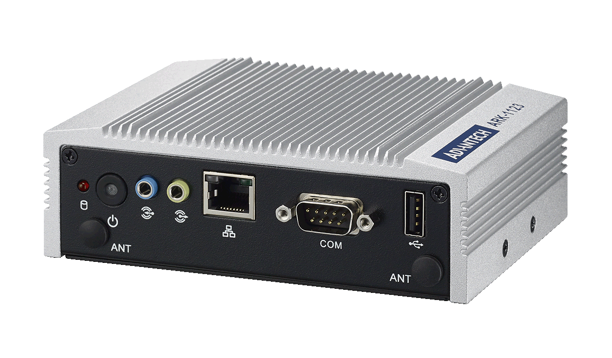
Available on Variety of Industrial Hardware

Slide 19
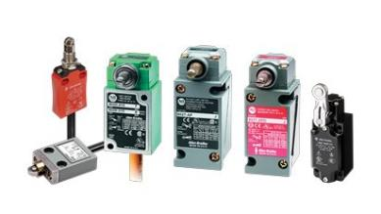
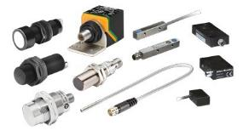
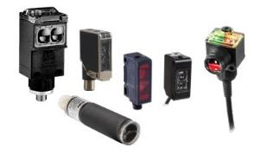
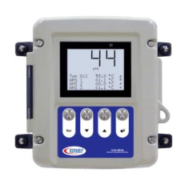
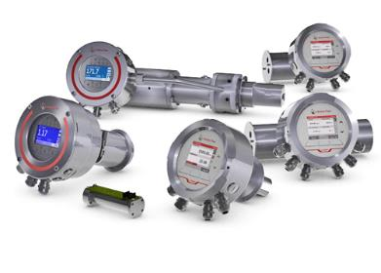
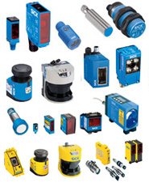
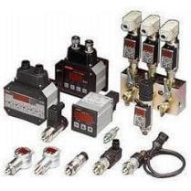
Collect Any Data
Many Existing South Plugins
Temperature, Humidity, Current, etc.
Modbus, OPC/UA, MQTT, HTTPS
Pluggable – Create Your Own
Easy APIs and sample code
Build your own
Customize existing plugins
Python or C++
Polled or Async
Open Source Community – many plugins in time

Slide 20

Transform Data In-Flight
Apply Mathematical Formula
Modify Metadata Values
Tag data with the machine or the floor it came from
Tag data with the component ID being manufactured
Summarize High-Frequency Data
RMS/Peak – calculate energy of oscillation
FFT – discover frequencies of oscillation/wobble
Machine Learning / Image Recognition on the Edge
Pluggable – Create your Own
Easy APIs and Sample Code
Python or C++

Slide 21
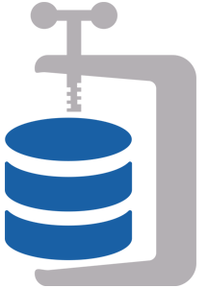
Intelligently Reduce Data Flow
Compress
Delta – only send changes
Conditional Forwarding
Forward last 5 minutes of data upon error condition
Pluggable – Create your own
Easy APIs and Sample Code
Python or C++

Slide 22
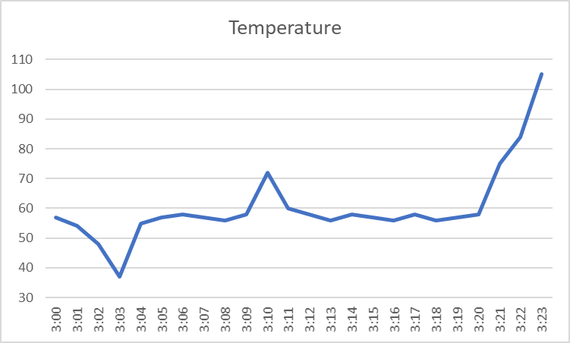
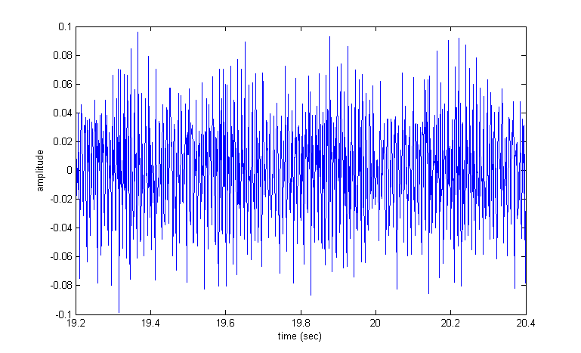
High Frequency / Vibration Data
Alert – Too Hot
Hot
Cold
Graph is Visually Meaningful
Can Create Alarm Thresholds
Low Volume (1 sample/sec)
Is this Graph Good? Is it Bad? Dunno
Can’t Create Alarm Thresholds
High Volume (1,000+ samples/sec)
Wastes expensive bandwidth
Consumes Disk/CPU

Slide 23
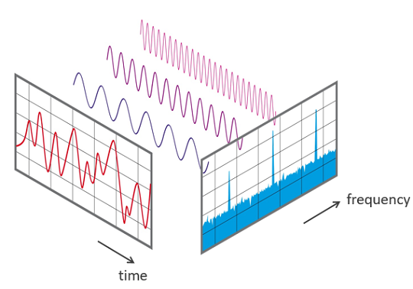
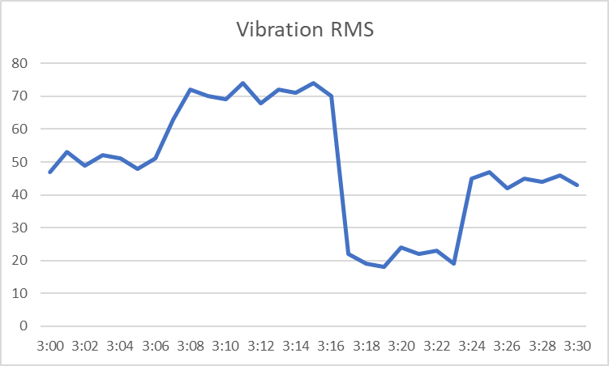
Enriching & Simplifying Data
RMS shows energy of vibration,
which shows speed & fatigue.
FFT shows energy at different
frequencies. Predict problems.

Slide 24
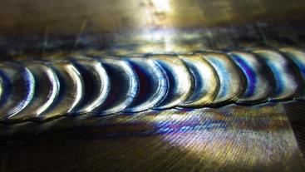
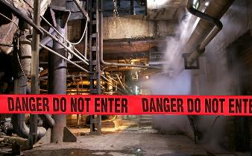
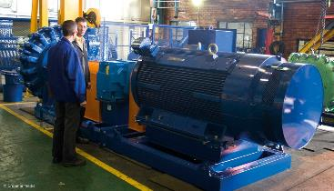
Machine Learning
Is this weld
high quality?
Are there people
in this
dangerous area?
Is this machine
healthy?
Google TensorFlow - Run ML Models at the Edge
Image Recognition / Object Detection / Anomaly Detection

Slide 25

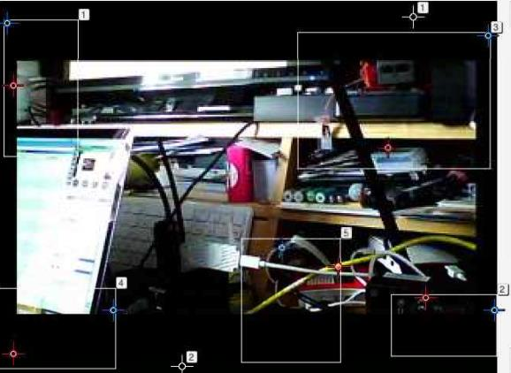
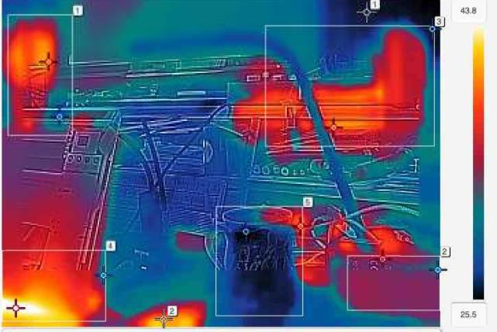
Thermal Imaging

Slide 26
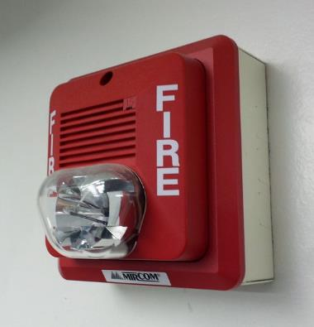
Event Detection at the Edge
Rules
Temperature goes over threshold
Current goes 20% above the average of last 5 minutes
Pluggable – Create complex rules across multiple assets
Actions
Create Asset Data
Run External Python App
Email / Slack / Send Message
Pluggable – Create your own

Slide 27
Fledge in Energy Predictive Maintenance Monitoring - Transformers

Slide 28
Fledge in Manufacturing Situation Awareness – Aircraft Paint Booths

Slide 29



Richard Beeson
Chief Technology Officer
OSIsoft LLC
richard@osisoft.com
Bill Hunt
Chief Technology Officer
Dianomic
bill@dianomic.com

